Slide 1


SMS COLLEGE RESULTS SYSTEM
Results, Upcoming semester Subjects, Preregistration;
All done through SMS

Slide 2
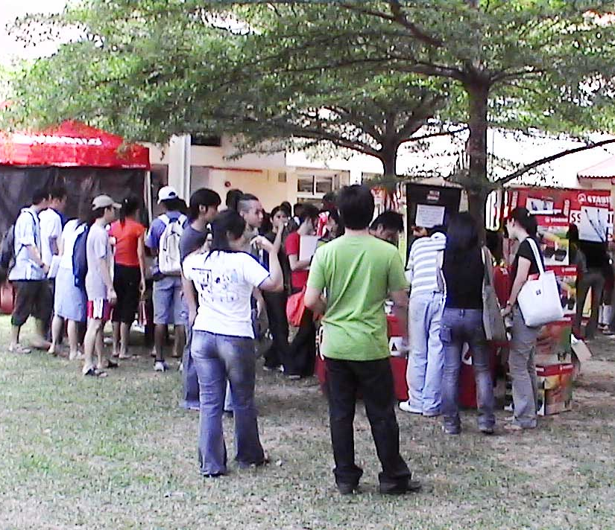
New Semester
Students line up for results
They flock HODs offices for Preregistration

Slide 3

SMS
Results could be checked via SMS
Subjects offered in the new semester
Even Preregistration, all done through SMS

Slide 4

SMS College Results System
Results;
New semester Subjects;
Preregistration;
right on your mobile phone

Slide 5
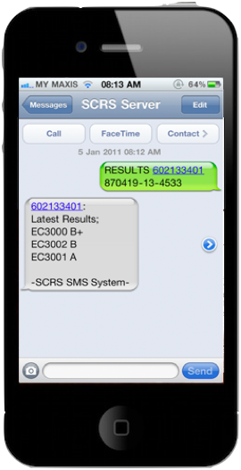
Results
Simply type:
RESULTS <space> Student ID <space> IC/Passport No.
Send to: 017 611 2415
Receive Results instantly

Slide 6

Subjects offered
Simply type:
SUBJECTS <space> Student ID <space> IC/Passport No.
Send to: 017 611 2415
Receive Subjects offered

Slide 7
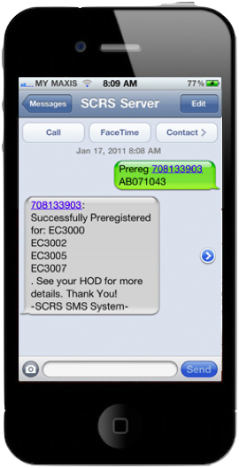
Preregistration
Simply type:
PREREG <space> Student ID <space> IC/Passport No.
Send to: 017 611 2415
Receive Preregistration Confirmation

Slide 8
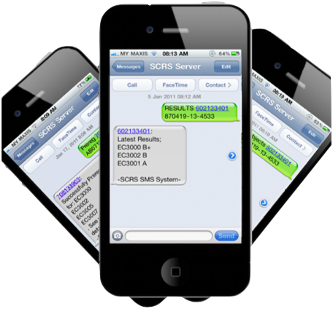
It’s going to change the way students interact with their colleges

Slide 9
Demo

